Slide 1

Project 4, Group 3 - tHE HOUSING MARKET IN THE UNITED KINGDOM
Group members: Najma, Sheyma, Vittorio

Slide 2

Dataset
The dataset used for this project is the UK House Price Index. It includes various features related to house prices across different regions in the UK over time. The data is collected and published by the UK Government. The dataset is publicly available and can be accessed through the UK Government's official website.
Aim
To analyze and predict house prices in the UK.
To identify key factors that influence house prices.
To understand regional differences and trends in the housing market.
Data Cleaning and Preparation:
Handling missing values and duplicates.
Converting categorical data to numerical format using one-hot encoding.
Normalizing and standardizing numerical features.

Slide 3
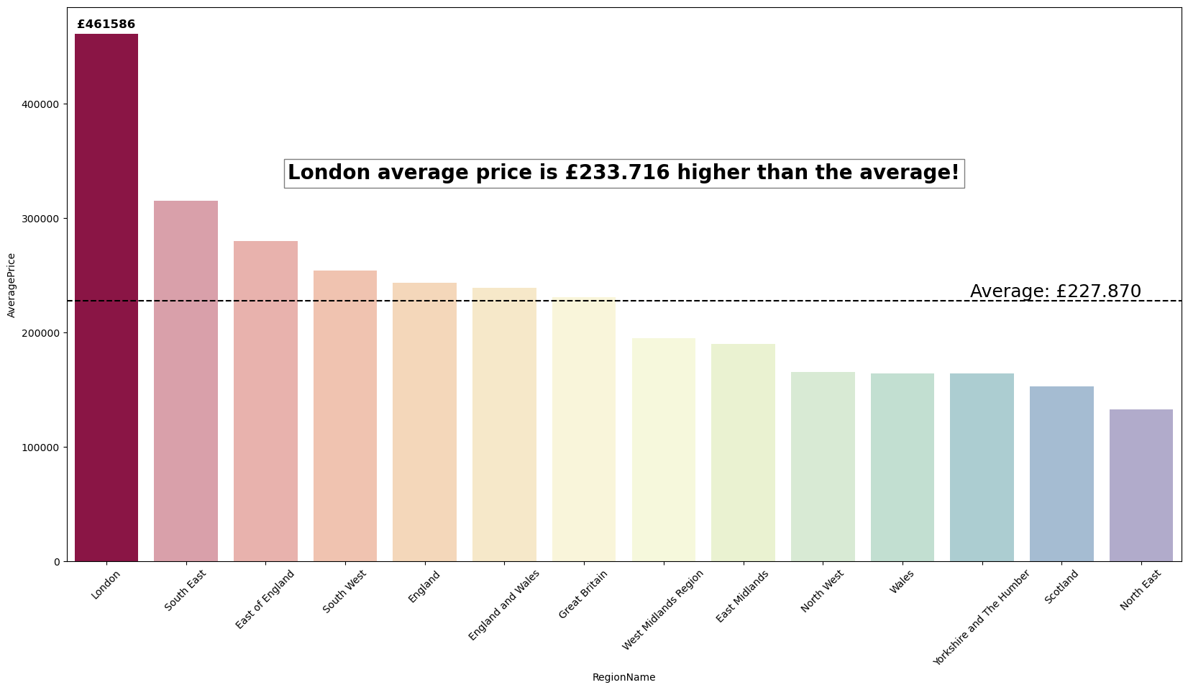
What region is the most expensive?
It does not come as a surprise for London to have the highest prices, followed by the rest of the south.
The south is perceived to come with lifestyle benefits such as the climate and landscape with fewer large cities and more natural land.

Slide 4
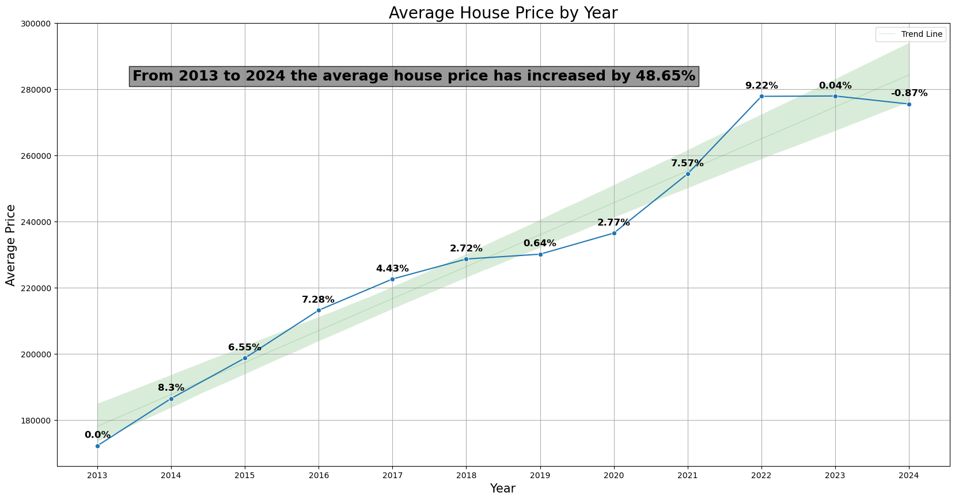
House Price over time
There are a number of factors that led to house price increase in the UK, including inflation, the high demand vs the low supply relative to the population growth.
Highest increase registered in 2022 with a 9.22% increase.

Slide 5
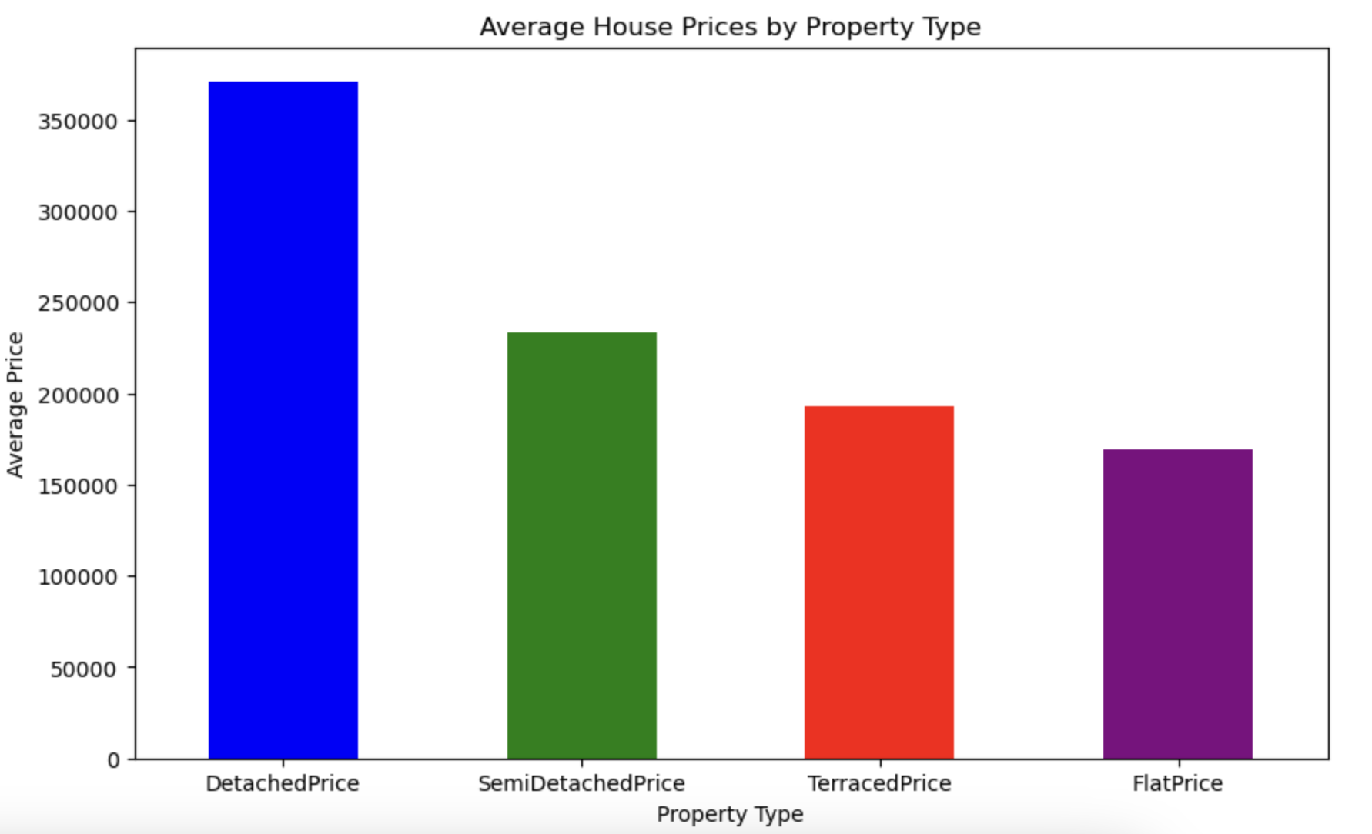
How do different types of properties like Detached, Semi-Detached, Terraced, Flats affect average house prices?
Sheyma
Detached houses have experienced the most notable price increases in the UK housing market, driven by several key factors. Firstly, the scarcity of detached houses compared to the abundance of flats, terraced, semi-detached, and other attached housing types creates higher demand. Detached houses typically offer more living space and privacy, which are highly valued by buyers. These properties often include private gardens, additional land, and gated entrances, contributing to their desirability and higher price points.
Moreover, the lifestyle and exclusivity associated with detached houses further enhance their appeal. Many buyers are willing to pay a premium for the space, tranquility, and status that come with owning a detached home. This contrasts with the more communal living situations in flats and terraced houses. The combination of limited supply and high demand for these premium properties drives up their prices, making detached houses the most expensive category in the UK housing market.

Slide 6
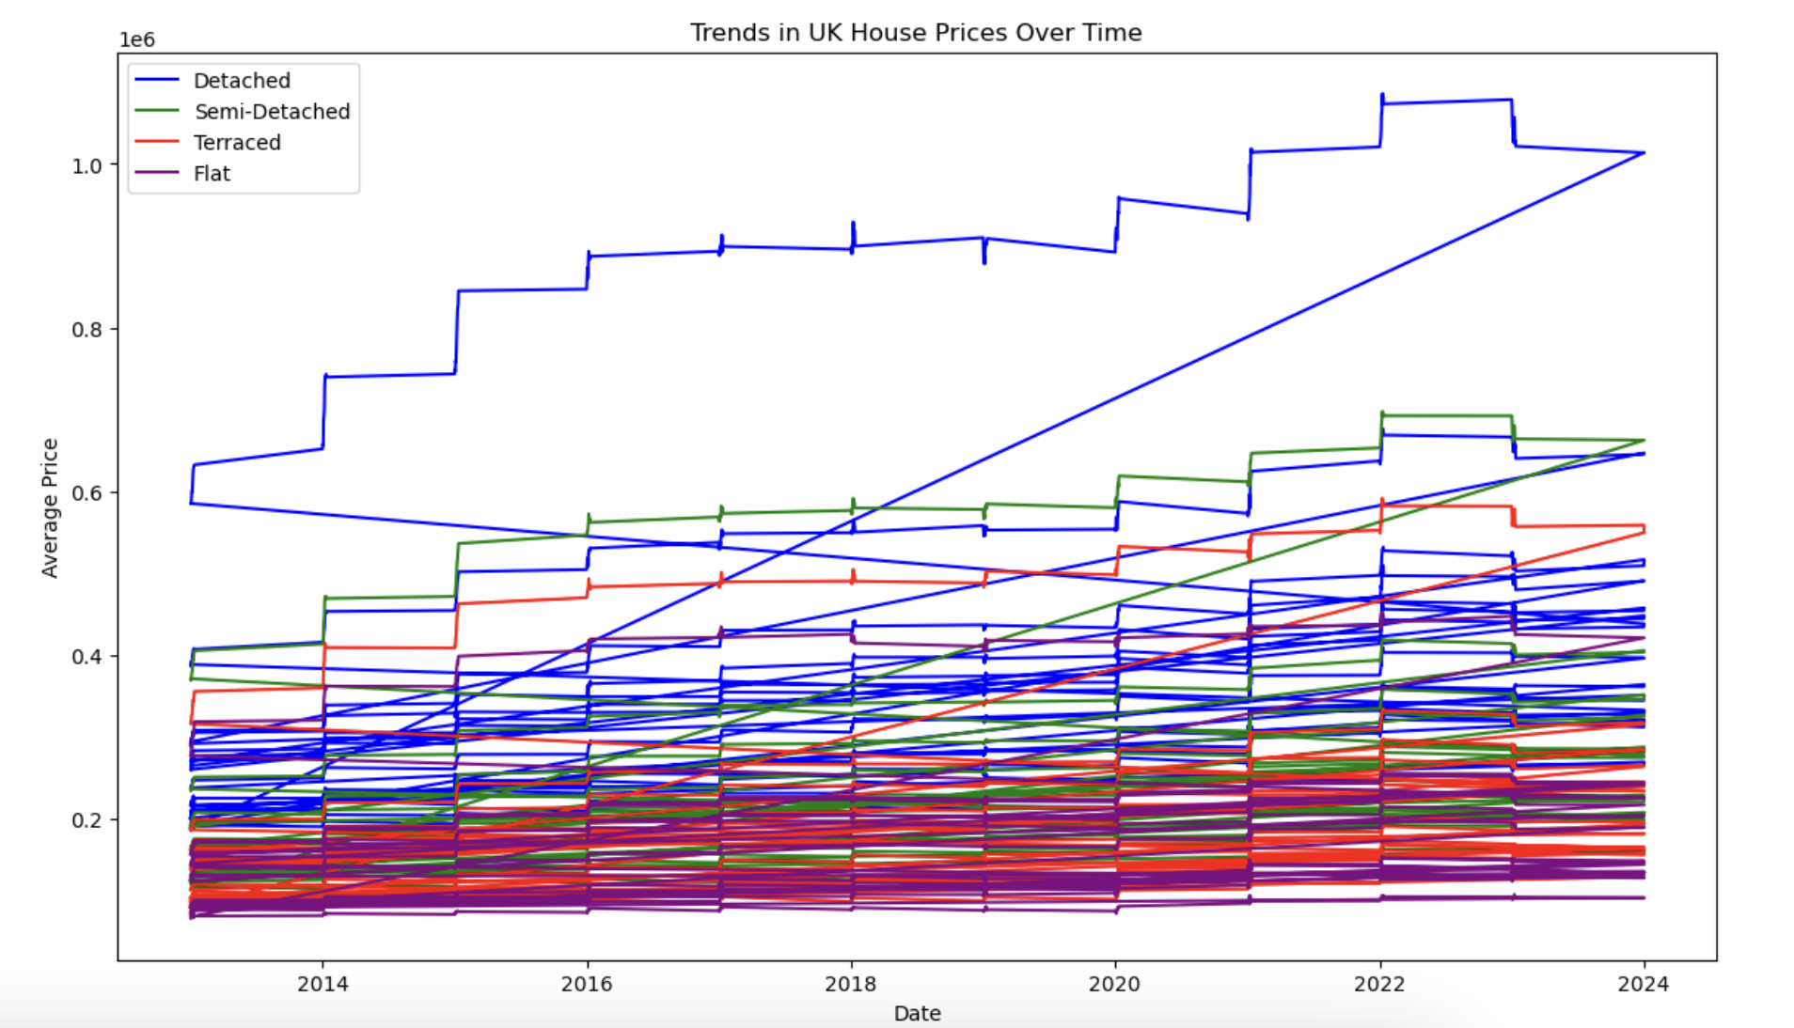
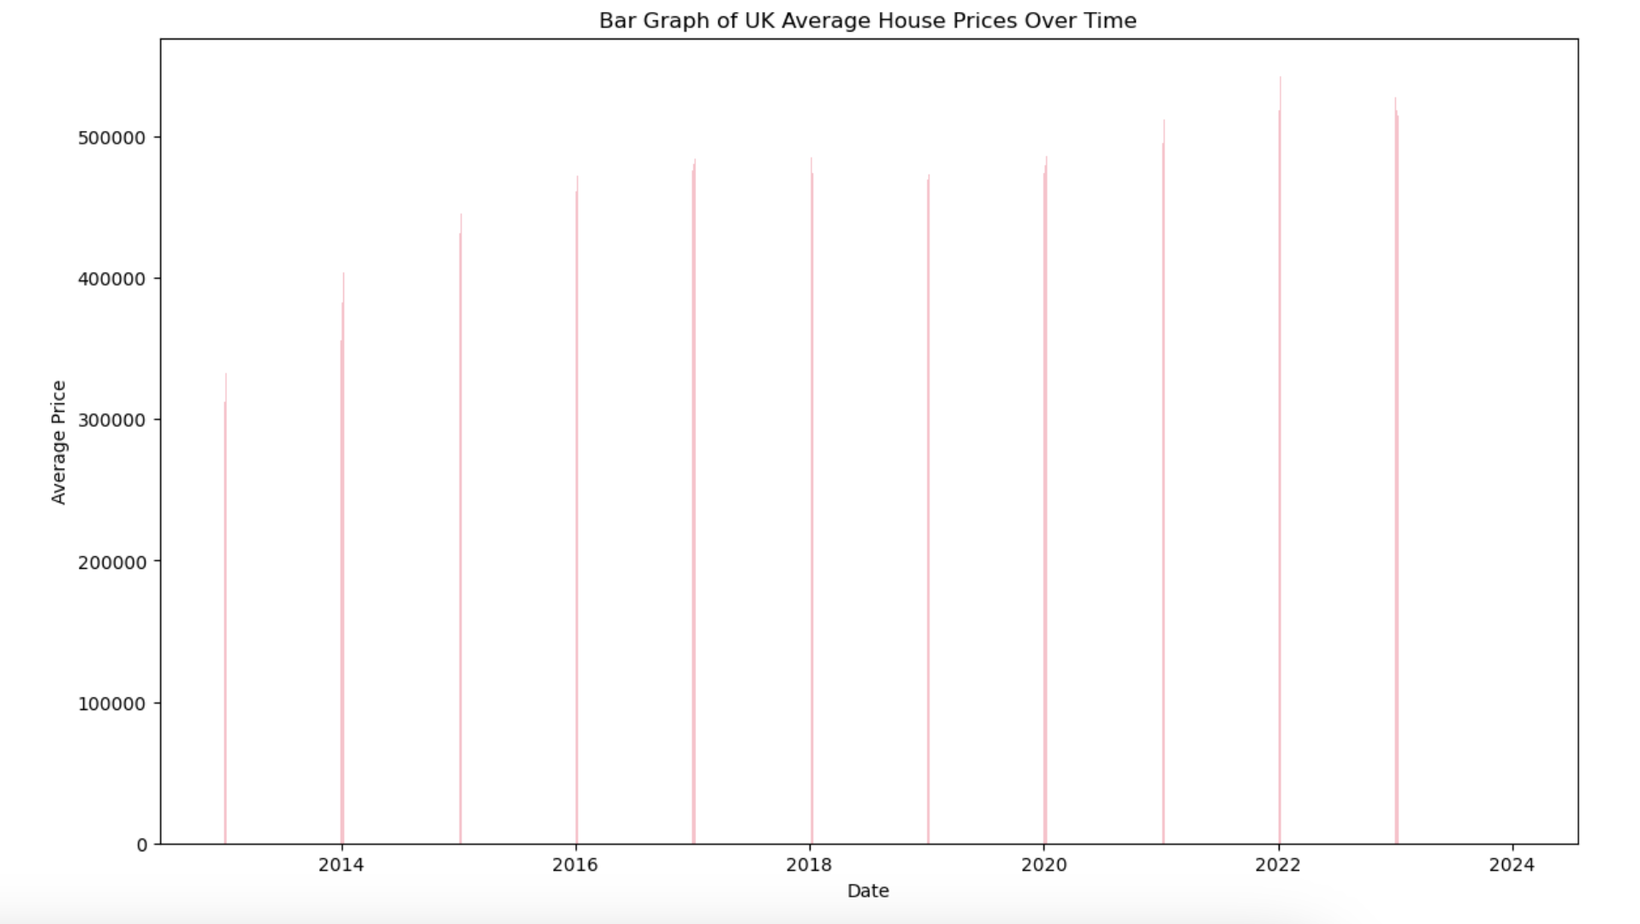
What trends can be observed in UK house prices over time?
Sheyma
We initially attempted to visualise this trend with a basic scatter plot, but the UK housing market's data was too sporadic for clear interpretation. To improve clarity, we switched to a basic bar graph, which provided a better visualisation of the data. This new visualisation revealed that the years 2024 and 2022 had the highest prices.
Additionally, the bar graph allowed us to observe trends and patterns over time more effectively, highlighting significant fluctuations in the housing market that were not as apparent in the scatter plot. This enhanced perspective helps us understand how different factors influenced housing prices during these peak years.

Slide 7
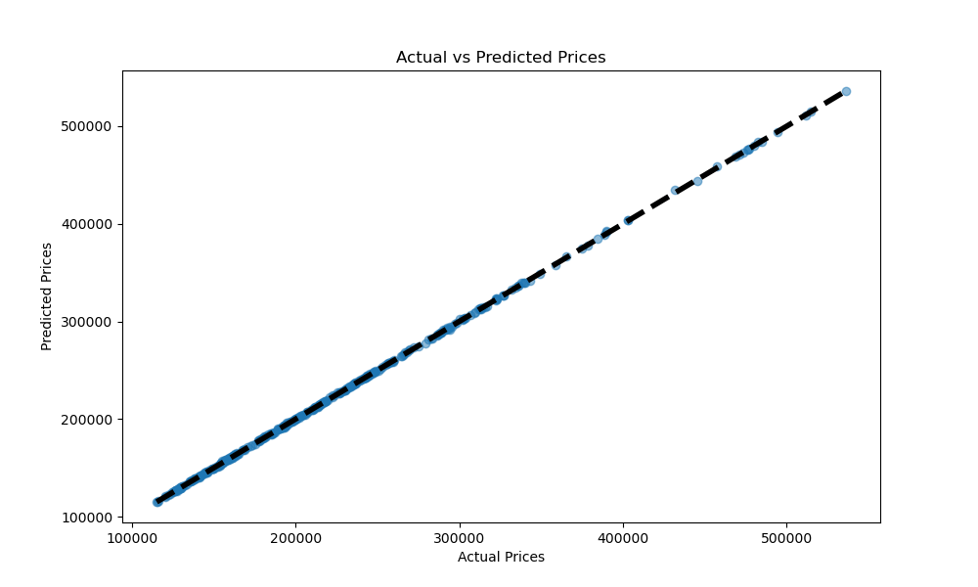
Model Performance: Actual vs Predicted House Prices
The plot visualizes the performance of our predictive model by comparing actual house prices to the prices predicted by the model.
The points closely follow the line, indicating that the model has high predictive accuracy.
This suggests that our model is highly effective in predicting house prices based on the features used.
High accuracy in predictions can be very valuable for real estate agents, buyers, sellers, and policymakers.
Reliable predictions can help in making informed decisions regarding property investments and pricing strategies.

Slide 8
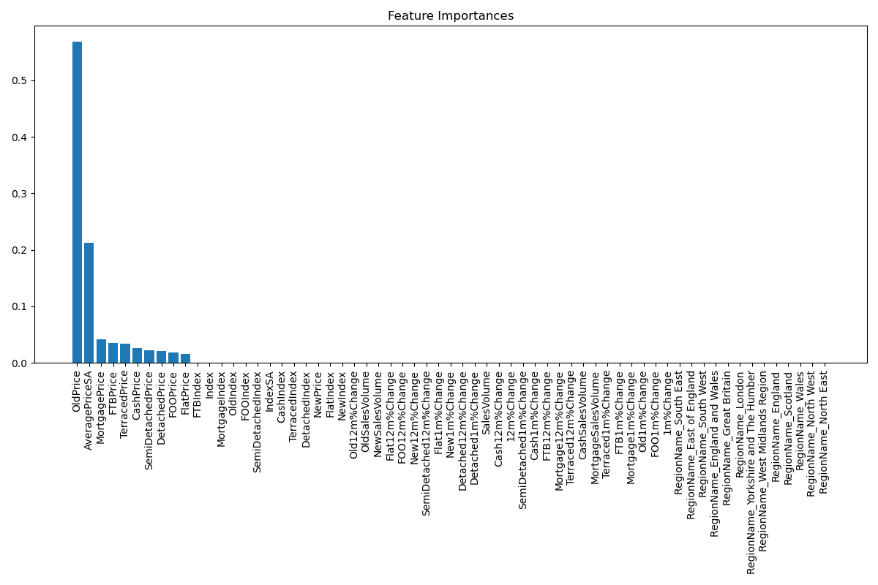
Feature Importances in Predicting House Prices
The plot shows the importance of various features in predicting house prices. It Highlights the most influential factors in predicting house prices. Feature importance indicates how much a given feature contributes to the prediction model.
Top Contributing Features:
OldPrice: Historical price of the property.
AveragePriceSA: Seasonally adjusted average price.
MortgagePrice: Prices of houses bought with a mortgage.
FTBPrice: Prices for first-time buyers.
Prices of different property types (e.g., SemiDetachedPrice, TerracedPrice, FlatPrice).
Various price indices and percentage changes.

Slide 9
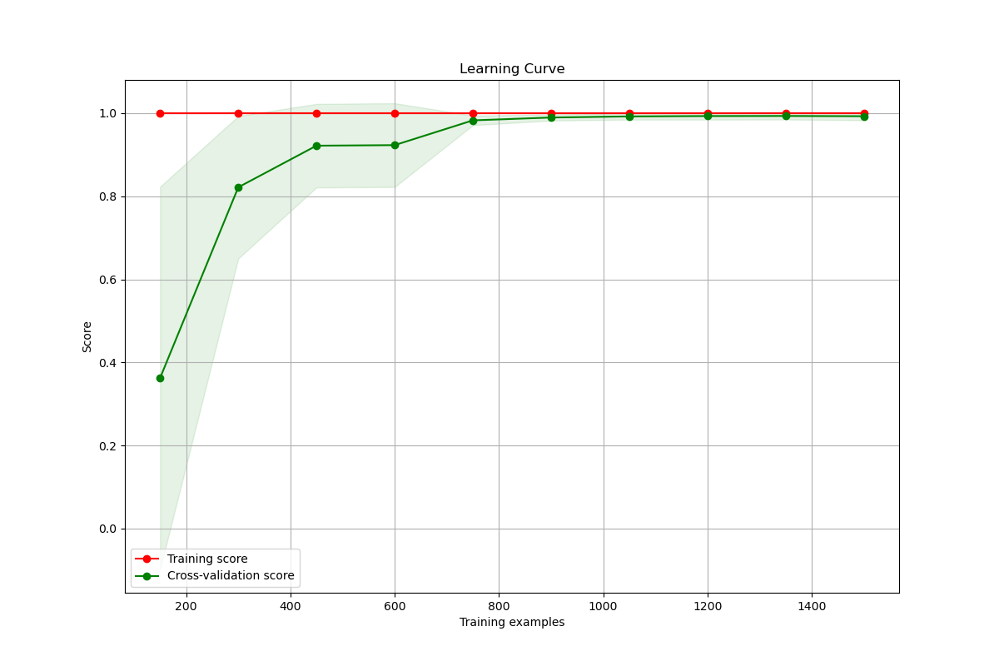
Learning Curve for House Price Prediction Model
This plot shows the model's performance with varying amounts of training data.
Training Score vs. Cross-Validation Score:
Red line: Training score (how well the model fits the training data).
Green line: Cross-validation score (how well the model generalizes to unseen data).
Training score is consistently high, close to 1.0. Cross-validation score improves with more training examples and stabilizes near the training score. Both scores converge at high values, indicating no overfitting or underfitting.

Slide 10
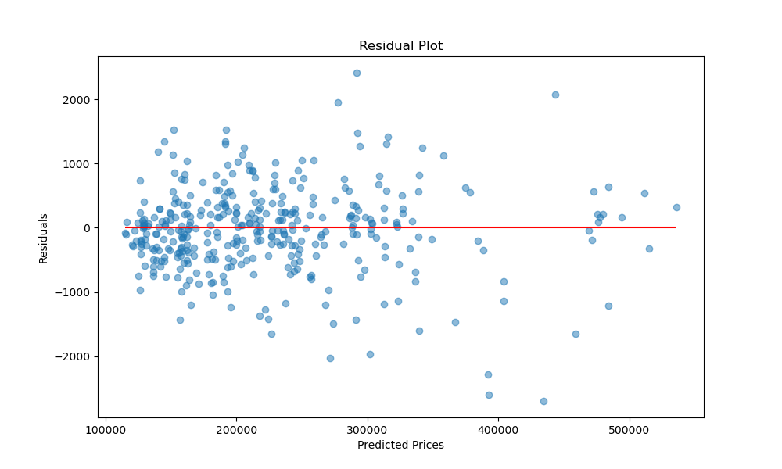
Residual Plot for House Price Prediction Model
The residual plot shows the differences between the actual house prices and the prices predicted by the model.
Residuals are the errors or deviations of the predicted values from the actual values.
This helps in refining the model for better accuracy.
Residuals are scattered around the zero-error line (red line).
Most residuals are close to zero, indicating accurate predictions.
A few outliers suggest larger errors in some predictions.

Slide 11
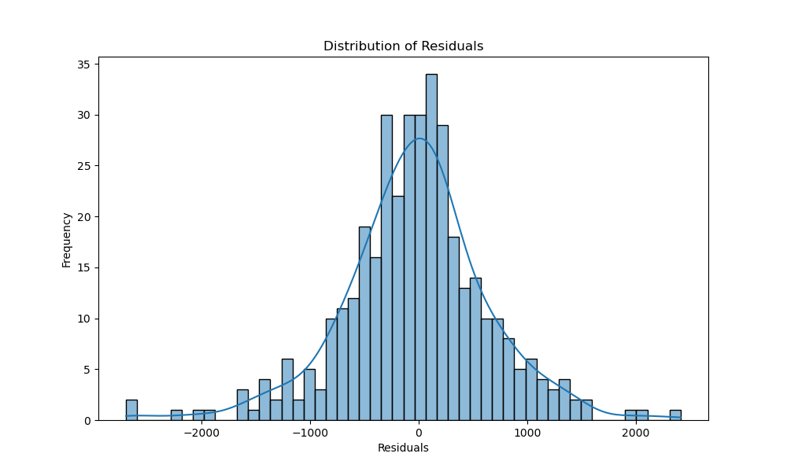
Distribution of Residuals
This plot shows the distribution of residuals (errors) between actual house prices and predicted prices.
Most residuals are centered around zero, indicating accurate predictions.
Few residuals on the extreme ends suggest larger errors in some predictions.
Normal distribution around zero suggests unbiased model performance.
Outliers indicate areas for potential model improvement.
This helps in refining the model and addressing biases.

Slide 12
Challenges and Limitations
Data Quality (missing values and inconsistencies)
Feature Selection (relevant features without overfitting)
Model Selection and Tuning (Choosing the right model and optimizing performance.)
Data Limitations (prediction errors and limited generalization to different market conditions)
Model Limitations
Computational Constraints due to large datasets
Overall, this project provided valuable insights into data science and machine learning in housing market analysis.

Slide 13
END

